Slide 1

Clinical TRIAL Dashboard
Presented by – Sumit Nerkar
Notes:
Welcome to the presentation on Clinical Trial Data Analysis. In this session, we’ll explore the insights derived from analyzing clinical trial data, highlight trends, and conclude with actionable recommendations to improve clinical trial operations.

Slide 2
Objectives
Analyze trial distribution across phases and therapeutic areas.
Investigate participant demographics and adverse events.
Evaluate trial status and outcomes for actionable insights.
Recommend strategies for improvement.
Notes:
The primary objective of this analysis is to break down the trial data into actionable insights. This includes distribution by phases and therapeutic areas, participant demographics, adverse events, and trial outcomes, culminating in recommendations for enhancing efficiency.

Slide 3
Problem Statement
Clinical trials are vital for medical advancement but are often hindered by inefficiencies.
Key challenges include trial duration, adverse event tracking, and resource allocation.
There is a need for data-driven solutions to optimize trial performance and improve outcomes.
Notes:
Clinical trials play a pivotal role in advancing medical science, but inefficiencies such as lengthy durations, ineffective resource allocation, and inconsistent adverse event tracking create significant challenges. Our objective is to harness data to address these issues

Slide 4
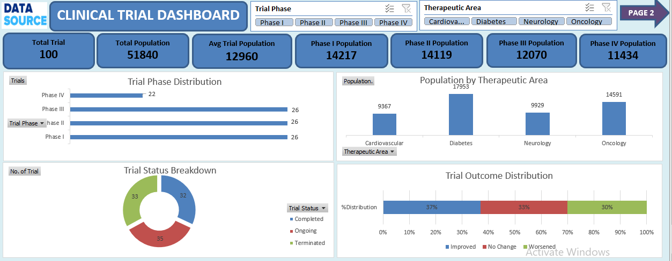

Slide 5
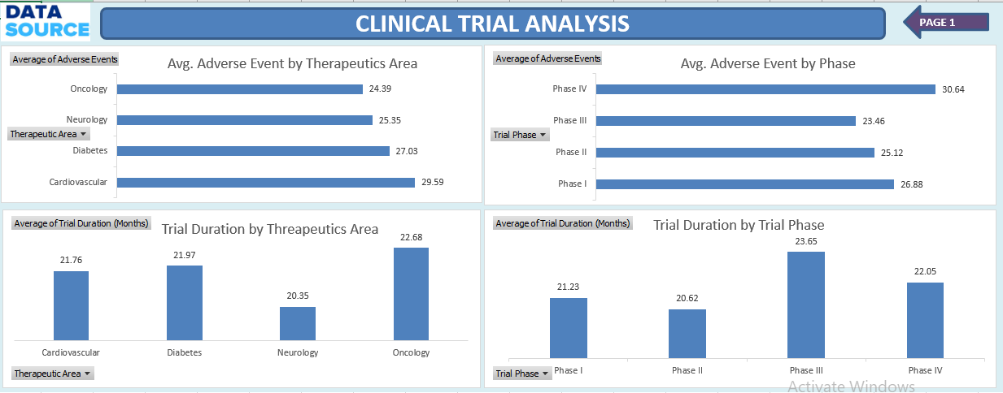

Slide 6
Methodology
Data Cleaning: Removed inconsistencies and standardized fields
Cleaning: Removed inconsistencies and standardized fields
Metrics Derived:
Trial Phase Distribution
Population Analysis
Adverse Event Rates
Trial Duration and Outcomes
Tools Used: Excel
Notes:
We utilized a structured approach for this analysis. Data was cleaned to ensure consistency, and we derived key metrics such as trial distribution, population trends, and adverse events. Tools like Excel, SQL, and Power BI facilitated comprehensive analysis

Slide 7
Insights - Trial Phase Distribution
40% of trials are in Phase 3, indicating focus on efficacy testing.
Early phases (Phase 1 and 2) comprise 35% of total trials.
Phase 4 trials account for 25%, reflecting post-approval monitoring.
Notes:
From the analysis, we found that 40% of trials are in Phase 3, emphasizing a focus on efficacy testing. Phases 1 and 2 make up 35%, while Phase 4 post-approval trials account for 25%, highlighting a balanced portfolio across trial stages

Slide 8
Population Analysis
Average participants per trial: 500
Therapeutic area with most participants: Oncology (700/trial)
Lowest participant count: Neurology (250/trial)
Notes:
On average, each trial has 500 participants. Oncology trials attract the most participants, with an average of 700 per trial, while neurology trials have the least at 250 participants. These variations reflect the scope and complexity of different therapeutic areas

Slide 9
Insights - Adverse Events
Average adverse events per trial: 20
Highest rate: Phase 3 (30 events/trial)
Lowest rate: Phase 1 (10 events/trial)
Notes:
“Adverse events analysis revealed an average of 20 events per trial. Phase 3 trials show the highest rate at 30 events per trial, reflecting larger participant pools. Early-phase trials have fewer events, indicating controlled testing environments.”

Slide 10
Insights - Geographic and Therapeutic Area Trends
Most active therapeutic area: Oncology (35% of trials).
Geographic focus: North America (50% of trials).
Notes:
Oncology dominates as the most active therapeutic area, with 35% of all trials. Geographically, North America leads in clinical research, hosting 50% of trials. This regional concentration aligns with healthcare infrastructure and research funding

Slide 11
Insights - Trial Outcomes and Duration
Outcome Analysis:
70% improved
20% no change
10% worsened
Average trial duration:
Phase 3: 24 months
Phase 1: 12 months
Notes:
Trial outcomes reveal that 70% show improvement, while 20% see no change, and 10% worsen. Average durations vary by phase, with Phase 3 taking 24 months and Phase 1 being the shortest at 12 months

Slide 12
Recommendations
Optimize Phase 3 timelines with streamlined processes.
Focus recruitment on underrepresented therapeutic areas like neurology.
Improve adverse event monitoring in later phases.
Expand trials to emerging regions to diversify data.
Notes:
Our recommendations include streamlining Phase 3 timelines, boosting recruitment in underrepresented areas like neurology, enhancing adverse event monitoring, and expanding trials geographically for diverse datasets

Slide 13
THANK YOU☺

